Slide 1
A Community Conversation about Springfield’s Portrait of a Graduate

Slide 2
Agenda
Introductions and Norms
Project Background
Group Discussion
Next Steps

Slide 3
Our Norms
Treat each other with dignity and respect, and avoid judgment.
Practice being open-minded
Build trust with others
Don’t hesitate to ask questions
Speak for yourself
Step up to speak your mind, step back to share the space
Honor the time schedule and agenda
Maintain confidentiality

Slide 4
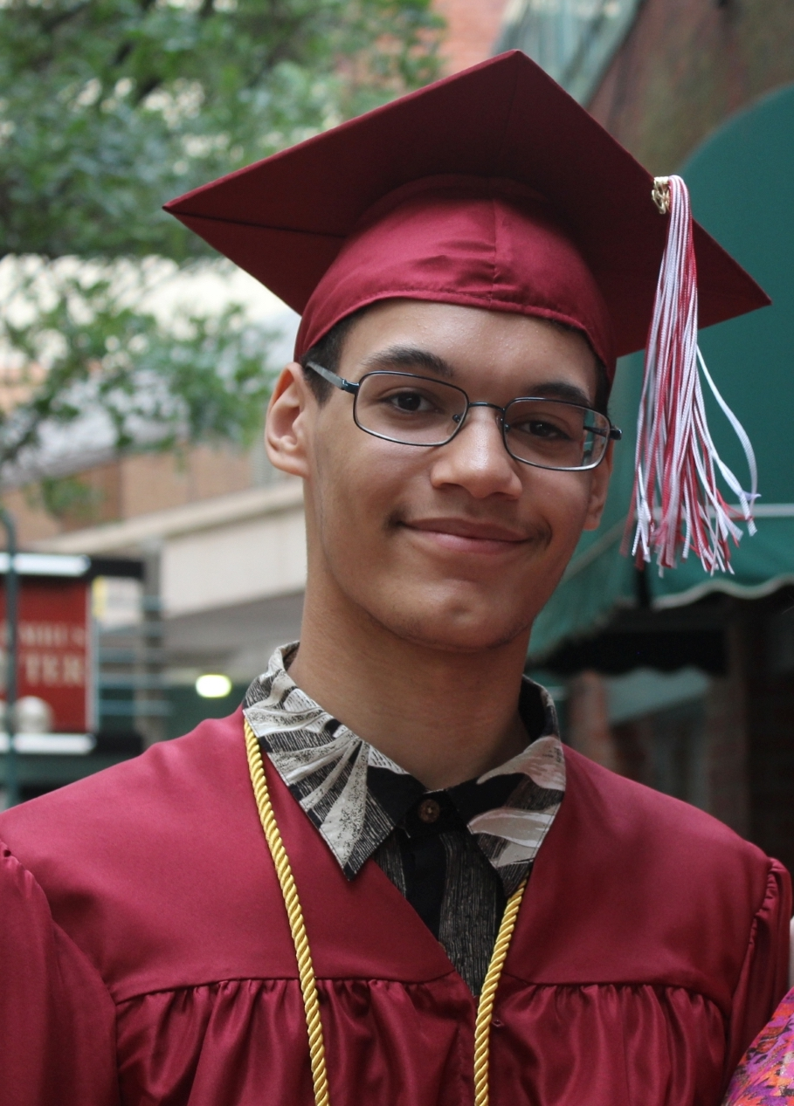
Why a Portrait of a Graduate?
The Springfield Public Schools is preparing to develop a new Strategic Plan focused on supporting all students to achieve their personal and professional goals.
We are undertaking a year-long project entitled Portrait of a Graduate, and intentionally engaging all stakeholders in the community, to obtain feedback.
The new strategic plan will be shaped by your feedback, and a series of Goals and Strategic Priorities will be developed that will guide the district.
Notes:
Point out that there are examples of Portraits of a Graduate from other communities on the tables.

Slide 5
What is a Portrait of a Graduate?
A collective vision that will articulate:
the hopes that our community has for our young people;
Notes:
Point out that there are examples of Portraits of a Graduate from other communities on the tables.

Slide 6
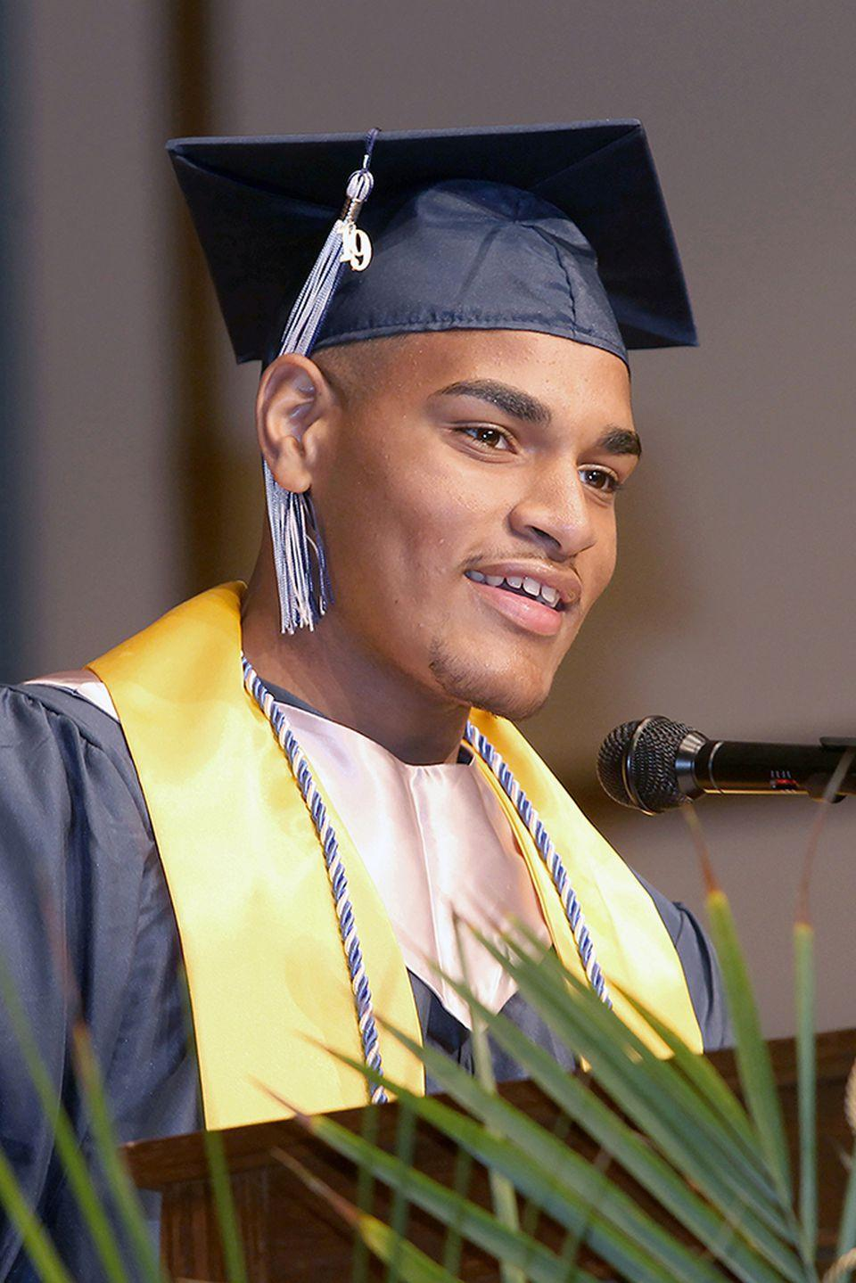
What is a Portrait of a Graduate?
A collective vision that will articulate:
the skills and attributes all SPS students need to be prepared for college, career and life.
Notes:
Kate

Slide 7
What is a Portrait of a Graduate?
The goal of this project is to create a vision that will inform teaching and learning kindergarten through 12th grade in Springfield.
Notes:
Kate

Slide 8
Project Timeline
By January 2020 - hold 15-20 community conversations
By May 2020 - hold 3 large community convenings
By August 2020 – complete draft Portraits of a kindergartner, fifth grader, eighth grader and SPS graduate
By October 2020 - share drafts with the community and get feedback
By January 2021 – publish the finished portraits

Slide 9
Group Discussion
First, go around your circle. Make sure that everyone has a chance to speak
Give the note-taker time to write down people’s ideas
Remember the norms

Slide 10
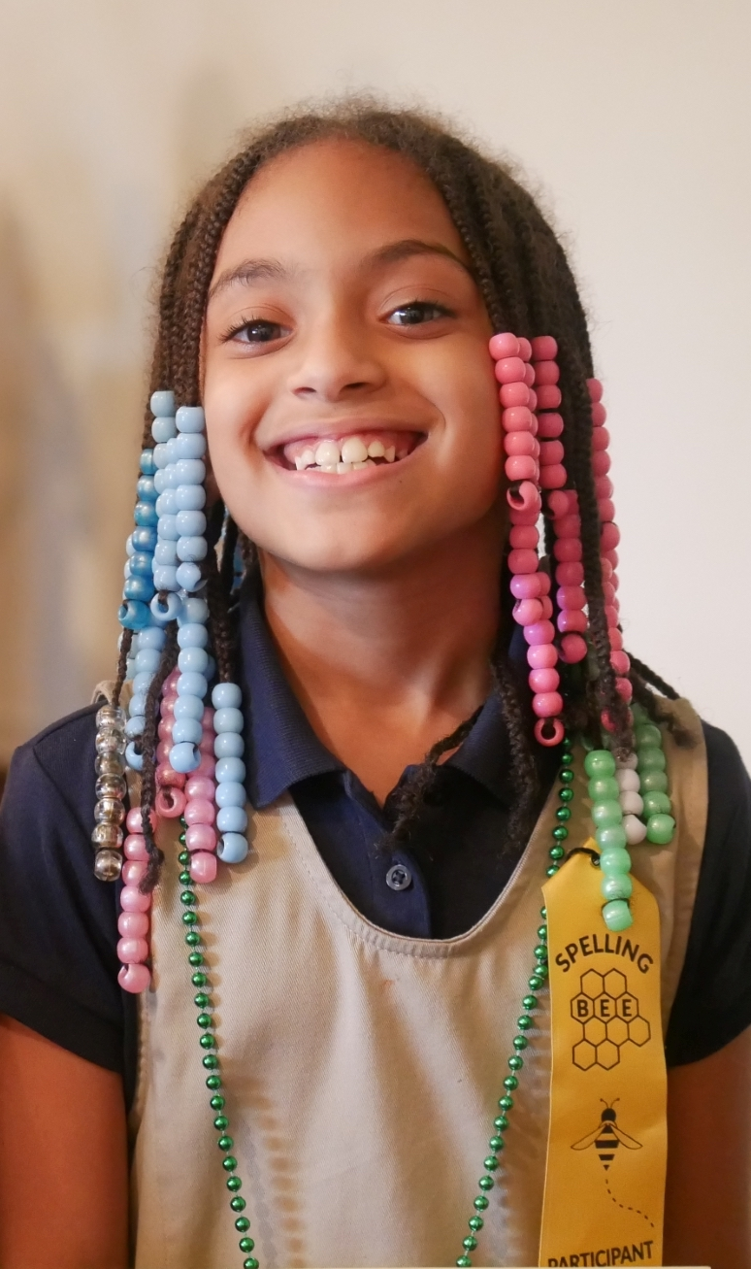
Essential Questions
Where do we want to go?
What are the hopes that our community has for our young people?
Notes:
Kate

Slide 11
Essential Questions
Where do we want to go?
What skills or attributes will be MOST IMPORTANT for SPS students to be prepared for college, career and life?
Notes:
Kate

Slide 12
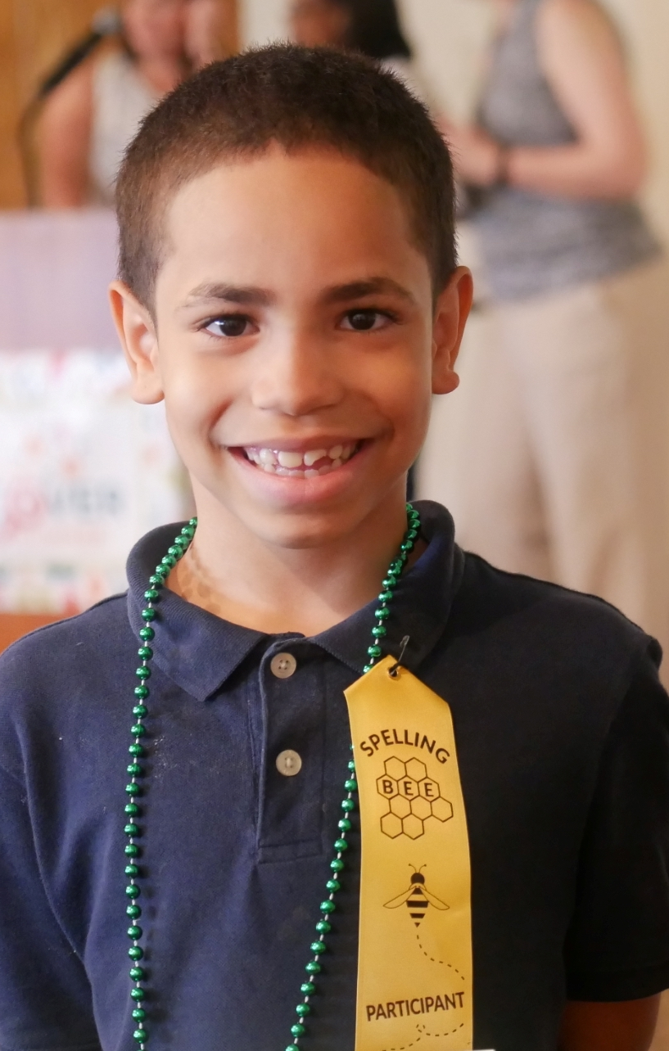
Essential Questions
Where do we want to go?
What skills and attributes do preschoolers, 5th graders, and 8th graders need as they progress toward success in high school and beyond?
Notes:
Kate

Slide 13
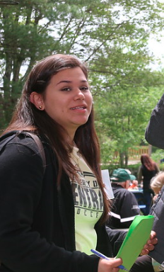
Essential Questions
Where are we now?
What are the elements of our current system that enable the schools to foster these skills and attributes?
Notes:
Examples of elements of our current system . . . (use to prompt the discussion)
Curriculum
Academic supports (tutoring, after-school help…)
Athletic Programs
Enrichment Programs
Transportation Systems
Vocational/Technical Programs
…… and many more……

Slide 14
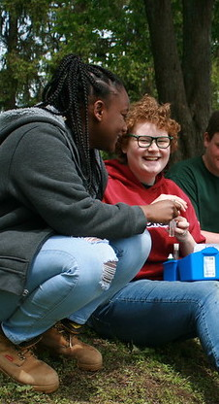
Essential Questions
Where are we now?
What are elements of our current system that could be improved or changed to help develop these skills and attributes in all students?
Notes:
Kate

Slide 15
Next Steps
Please complete the exit survey before leaving
Watch your email and social media for project updates
Join us, and bring friends and colleagues, to the Portrait of a Graduate community convenings in April and May

Slide 16
Thank you

